Slide 1
Image Processing Project
Single image super-resolution
Author
Rami Soussi

Slide 2
Interpolation-based method
Traditional interpolation algorithms :
Bilinear interpolation
Nearset neighbor interploation

Slide 3
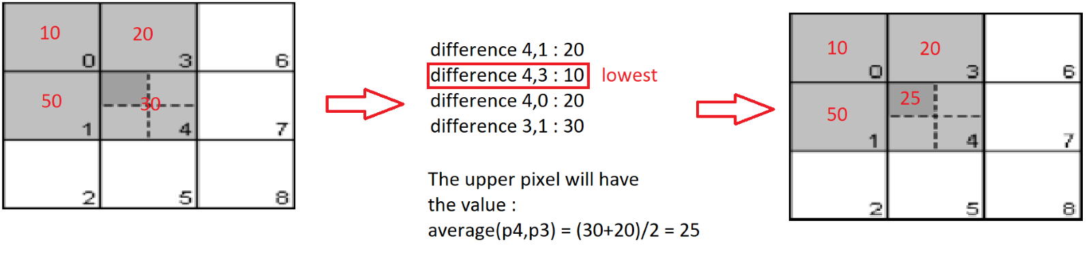
Directionally averaging scaling algorithm

Slide 4
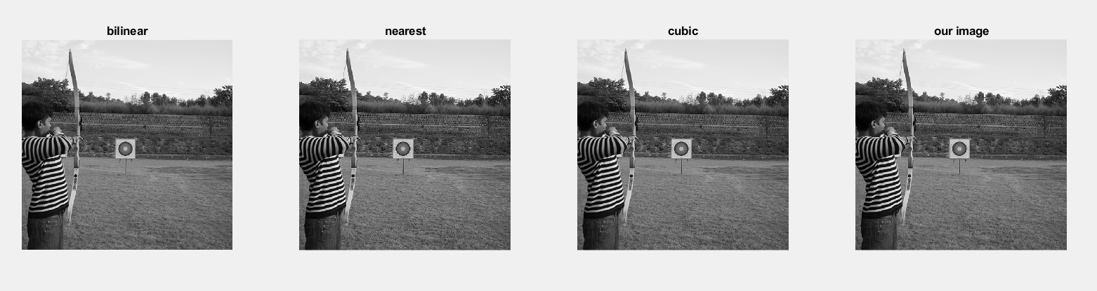
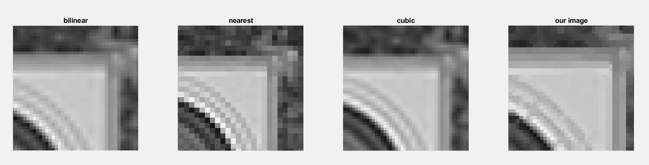
Results

Slide 5
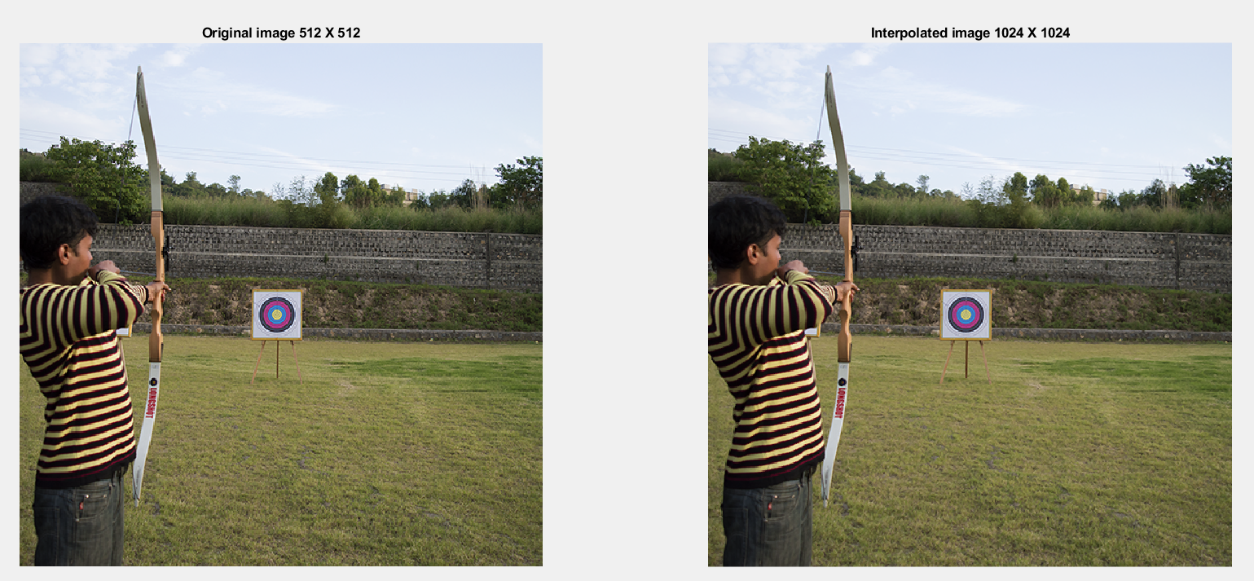
Results on coloured image

Slide 6
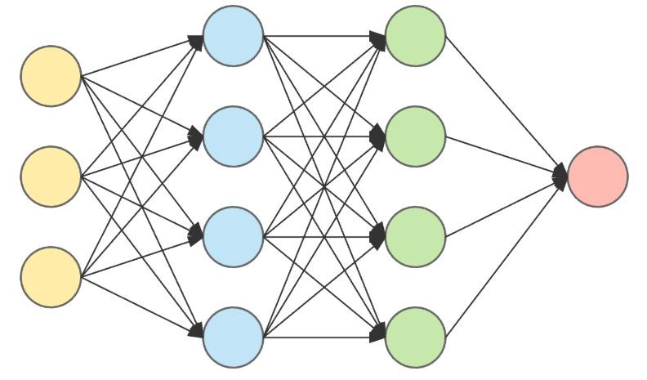
Learning-based methods

Slide 7
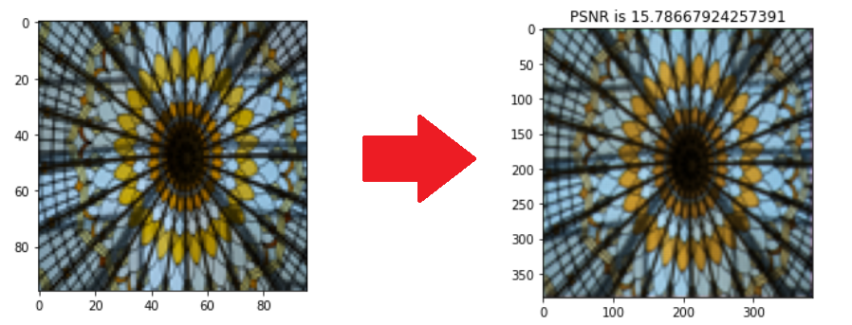
Results

Slide 8
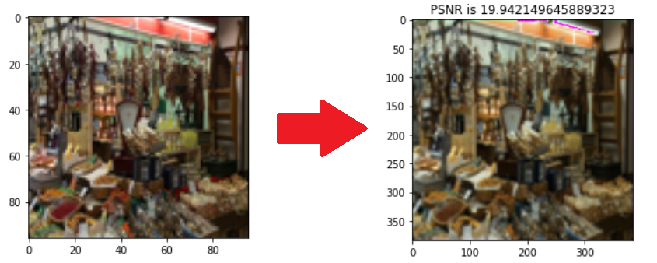

Slide 9
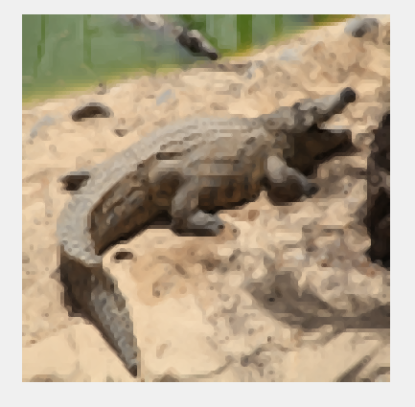
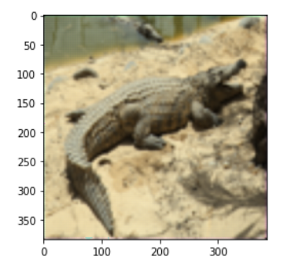
Comparison between the two methods
 | Interpolation-based | Learning-based
RESULT IMAGE
PSNR | 21.8848 | 21.7462

Slide 10
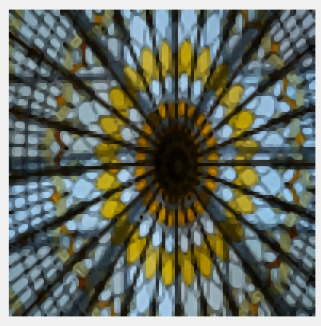
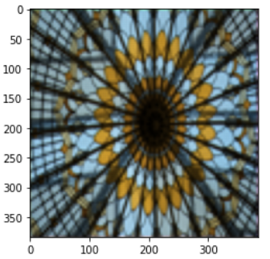
 | Interpolation-based | Learning-based
RESULT IMAGE
PSNR | 15.6823 | 15.7866

Slide 11
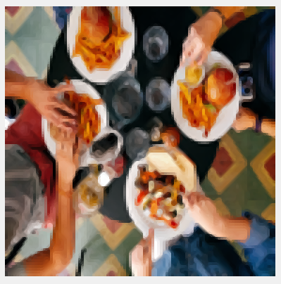
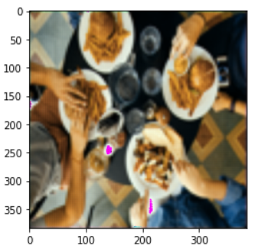
​ | Interpolation-based ​ | Learning-based ​
RESULT IMAGE ​ | ​ | ​
PSNR ​ | 21.4328​ | 20.6247

Slide 12
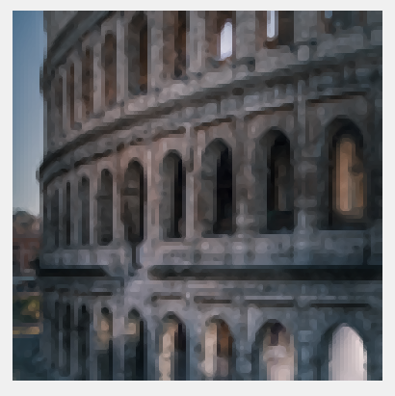
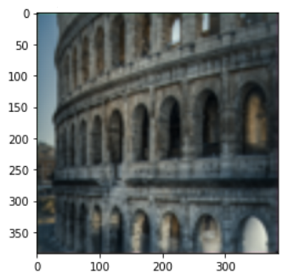
​ | Interpolation-based ​ | Learning-based ​
RESULT IMAGE ​ | ​ | ​
PSNR ​ | 23.8087 | 24.0141 ​

Slide 13
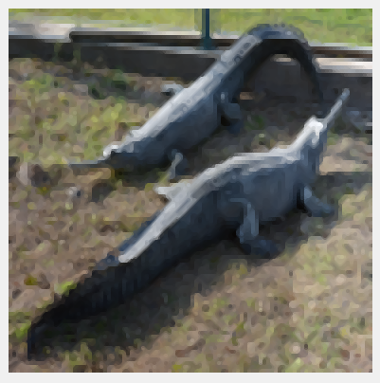
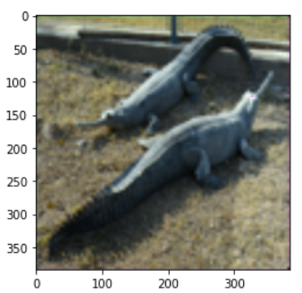
​ | Interpolation-based ​ | Learning-based ​
RESULT IMAGE ​ | ​ | ​
PSNR ​ | 20.4397 | 20.4546

Slide 14

Thank you for your attention

